Slide 1
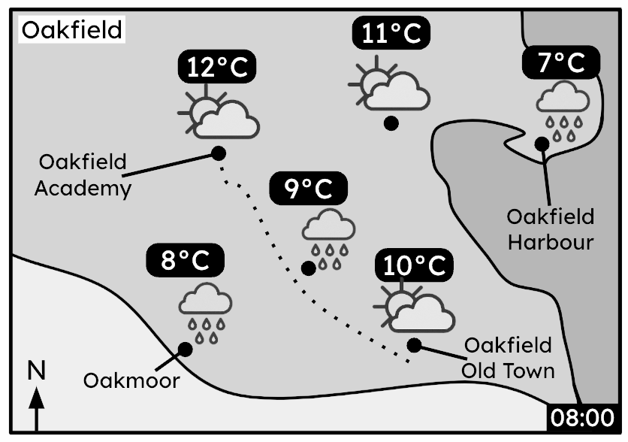




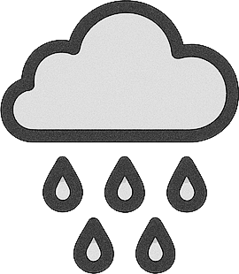

Understanding weather data
Task A: Understanding a basic weather forecast
1) At 8 am, Sofia cycles to Oakfield Academy from her house near the Old Town. The dotted line shows Sofia’s route.
Sofia has the following items:
sunglasses (for constant sunny weather)
raincoat (for any amount of rain)
scarf (if the temperature drops below 10°C)
Which should she bring for her journey to Oakfield Academy? Justify your answer for each one.
2) This weather report shows weather data for 1st June 2024.
00:00 | 02:00 | 04:00 | 06:00 | 08:00 | 10:00 | 12:00 | 14:00
9°C | 10°C | 8°C | 10°C | 13°C | 12°C | 11°C | 12°C
weather at “Oakfield Harbour”
a) Between which two times is sunrise?
b) Describe the trend in the weather conditions between 8 am and 12 pm.
c) What is the mean temperature during the night-time hours?
d) Which of these weather conditions is likely at 1 pm? Justify your choices.
sunny
sunny intervals
rain showers
heavy rain
lightning

Slide 2

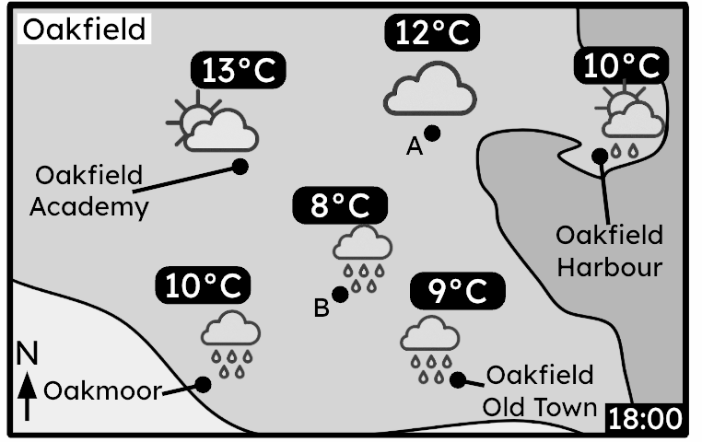
Understanding weather data
3) The weather report is for a location in Oakfield.
00:00 | 03:00 | 06:00 | 09:00 | 12:00 | 15:00 | 18:00 | 21:00
6°C | 5°C | 9°C | 12°C | 13°C | 12°C | 10°C | 10°C
a) Which location in Oakfield does this weather report most likely represent?
b) What is the range of temperatures at this location?
c) The range of temperatures at location A is the same as the range in the report location. What are the maximum and minimum temperatures at location A?
2

Slide 3
Understanding weather data
Task B: Analysing extra forecast information
1) This weather report shows the weather forecast for Oakfield Harbour.
 | 00:00 | 03:00 | 06:00 | 09:00 | 12:00 | 15:00 | 18:00 | 21:00
air temperature | 13°C | 15°C | 15°C | 22°C | 24°C | 18°C | 14°C | 12°C
wind speed (km/h) | 2 | 5 | 7 | 3 | 8 | 14 | 11 | 2
wind direction | ↗ | ↑ | ↑ | ← | ← | ← | ← | ←
“feels like” | 13°C | 14°C | 14°C | 21°C | 22°C | 14°C | 10°C | 9°C
a) Which wind directions results in the most and least difference between air temperature
and the “feels like” temperature?
b) A cold front will blow over Oakfield Harbour. Using the weather report, write down the
most likely time this will happen, and justify your answer.
2) Humidity measures the amount of moisture in the air. It also influences “feels like” temperature.
Weather report on 1st July at Oakfield Old Town.
Weather report on 10th July at Oakfield Old Town.
 | 08:00 | 11:00 | 14:00 | 17:00
air temperature | 6°C | 10°C | 17°C | 18°C
humidity | 30% | 45% | 70% | 65%
“feels like” | 5°C | 12°C | 20°C | 20°C
 | 08:00 | 11:00 | 14:00 | 17:00
air temperature | 6°C | 10°C | 17°C | 18°C
humidity | 20% | 20% | 15% | 15%
“feels like” | 5°C | 9°C | 16°C | 17°C
a) On which day, and at what time, was there the greatest difference between the air temperature and the “feels like” temperature?
b) Complete this sentence:
“Higher humidity likely leads to an ___________ in “feels like” temperature compared to air temperature.”
c) What weather conditions might result in higher humidity?
3

Slide 4
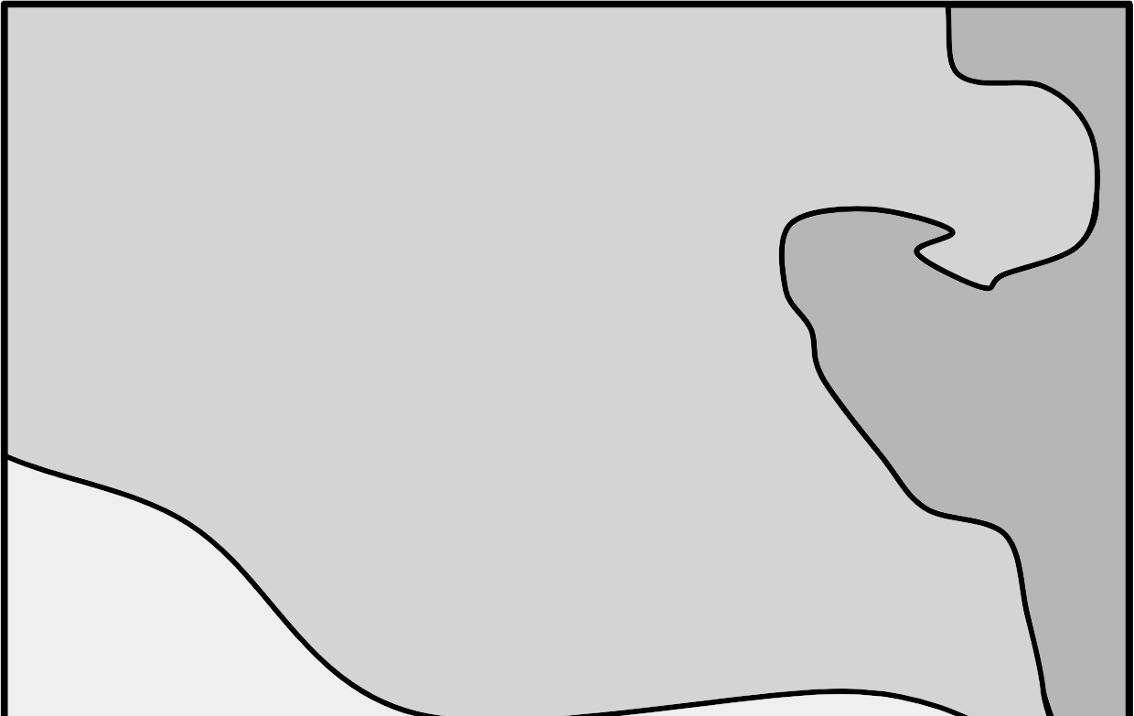
Understanding weather data
3) Using the information given on the weather map and weather report, make a sensible
prediction on the missing details of the weather conditions at 4 pm at Oakmoor.
Write a sentence justifying your prediction.
 | 12:00 | 16:00
air temperature | 11°C
wind speed (km/h) | 8 | 12
wind direction | ↙ | ↙
% chance of rain | 20%
“feels like” | 13°C
Oakfield
Oakfield
Academy
A
Oakfield
Harbour
B
N
Oakfield
Old Town
Oakmoor
12:00
weather at “Oakmoor”
Mathematics in Education and Industry
v2.4

